Slide 1
3D Diffusion Policy:
Generalizable Visuomotor Policy Learning via Simple 3D Representation
GONG Ying
gong.ying@connect.umac.mo
2024.5.10

Slide 2
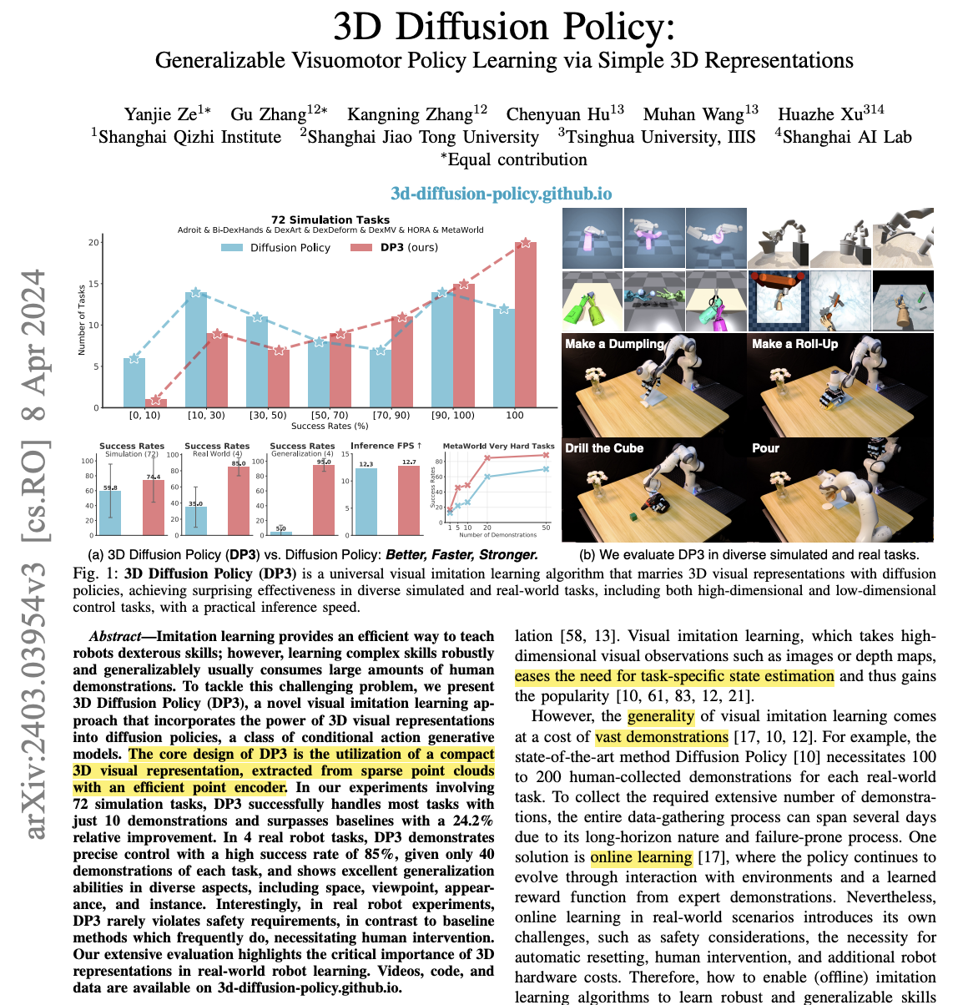
arXiv:2403.03954v3
Apr. 8 2024

Slide 3
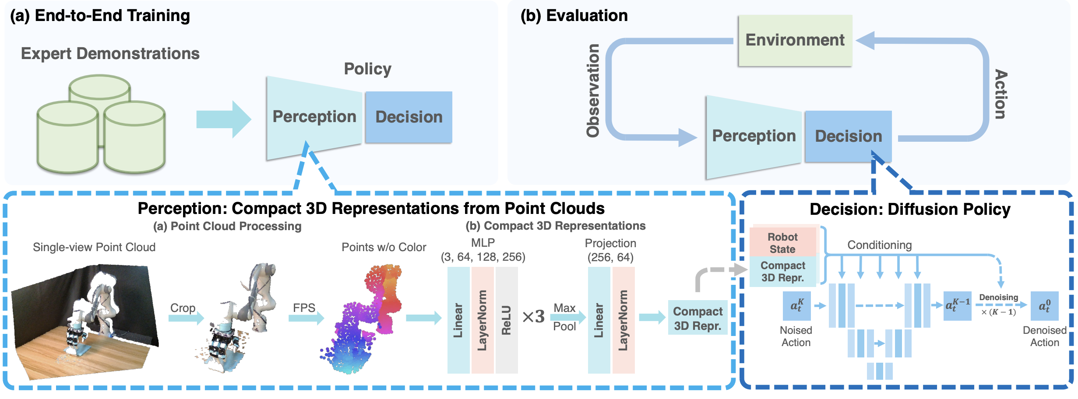
Overview

Slide 4
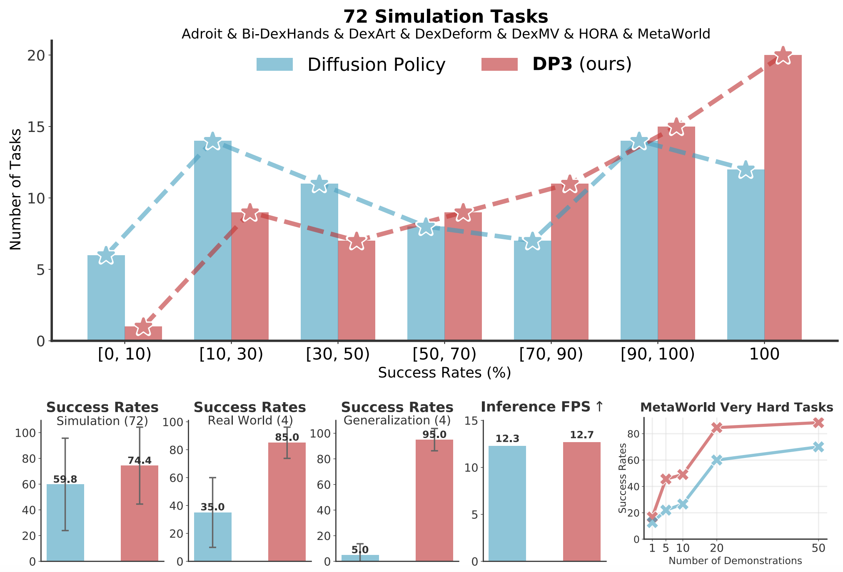
Experiments

Slide 5

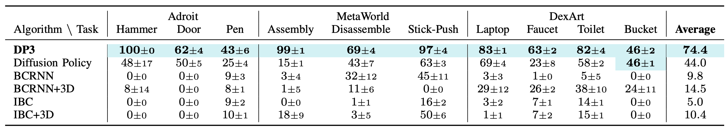
Experiments (Simulation)
Comparisons

Slide 6
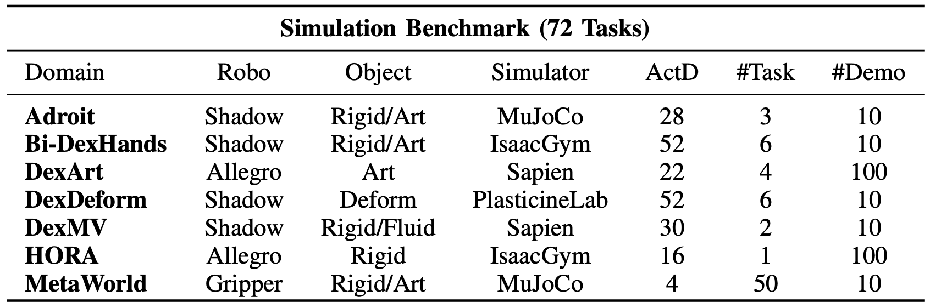
Experiments (Simulation)

Slide 7
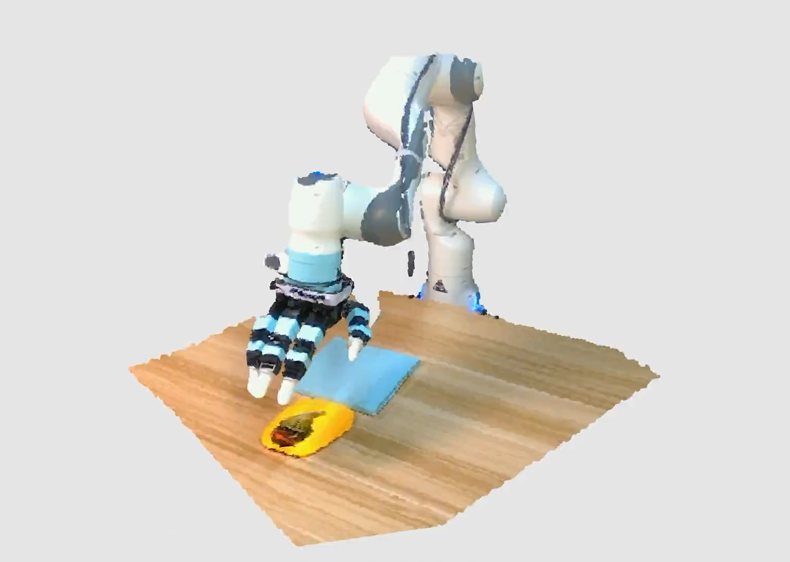
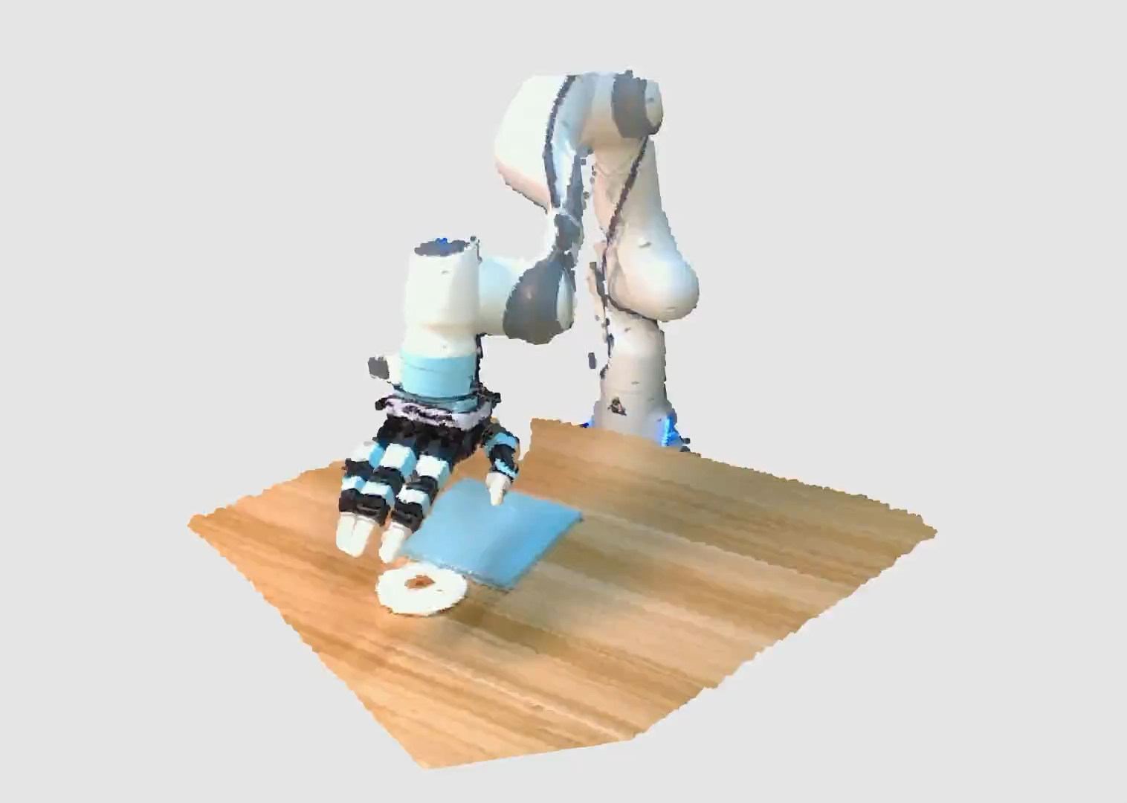
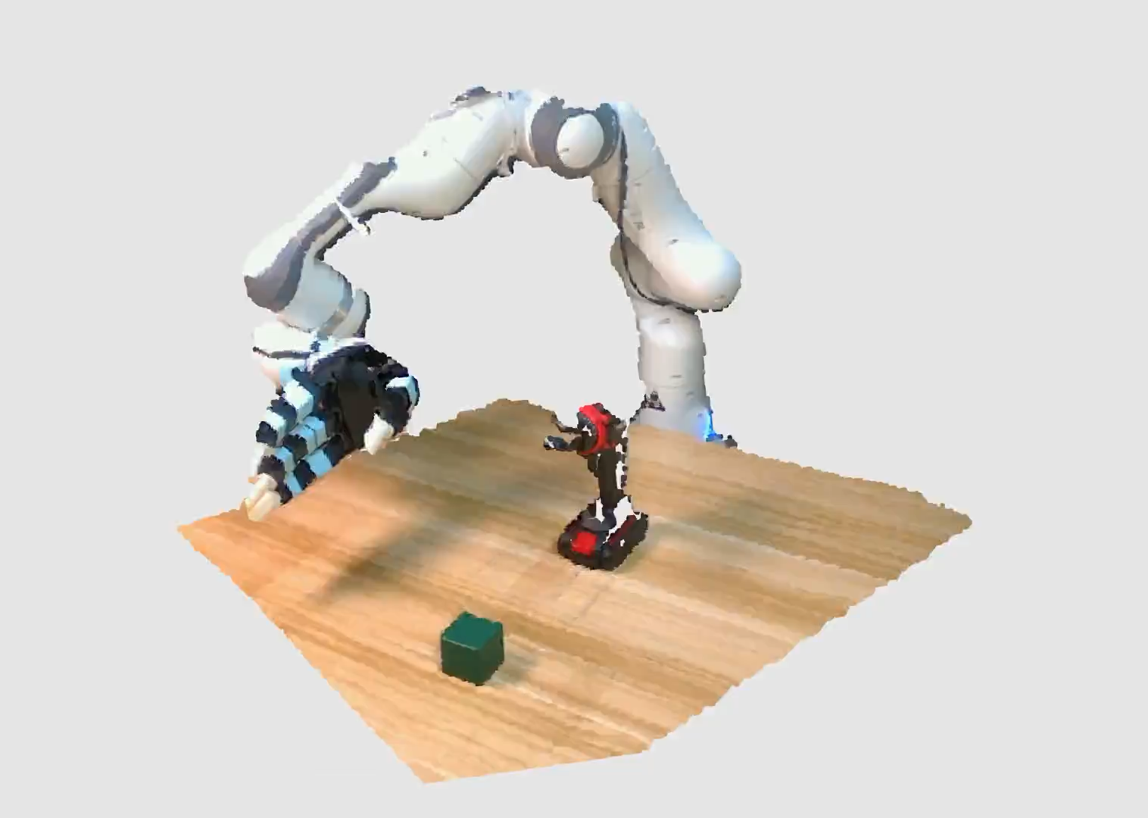
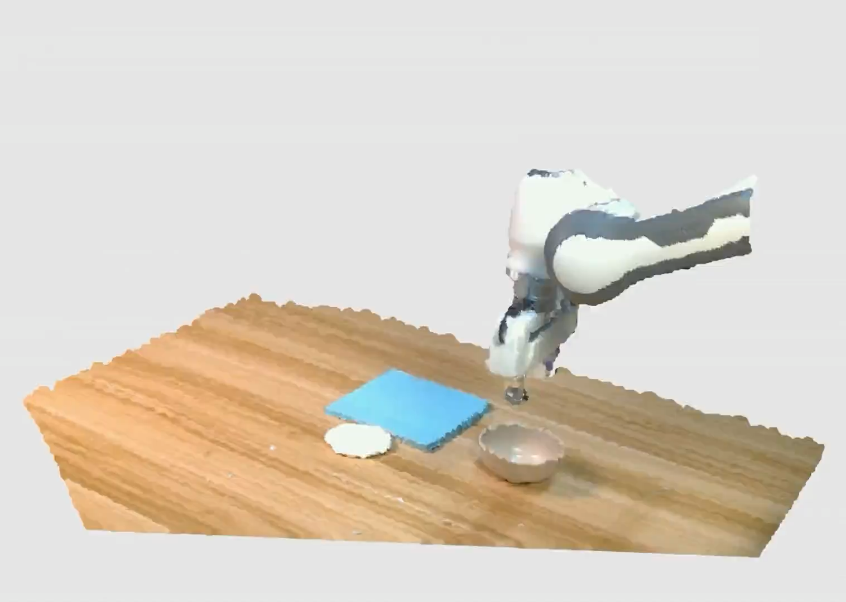
Experiments (Real Robot)

Slide 8
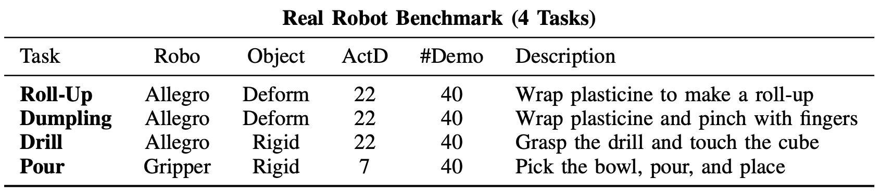
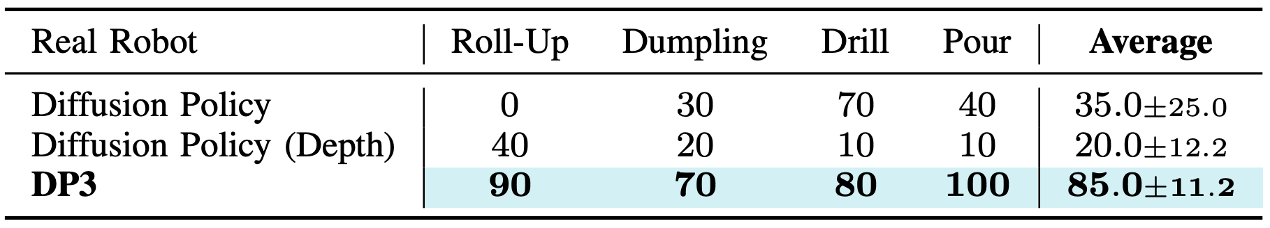
Experiments (Real Robot)

Slide 9
Thank you.

